Slide 1
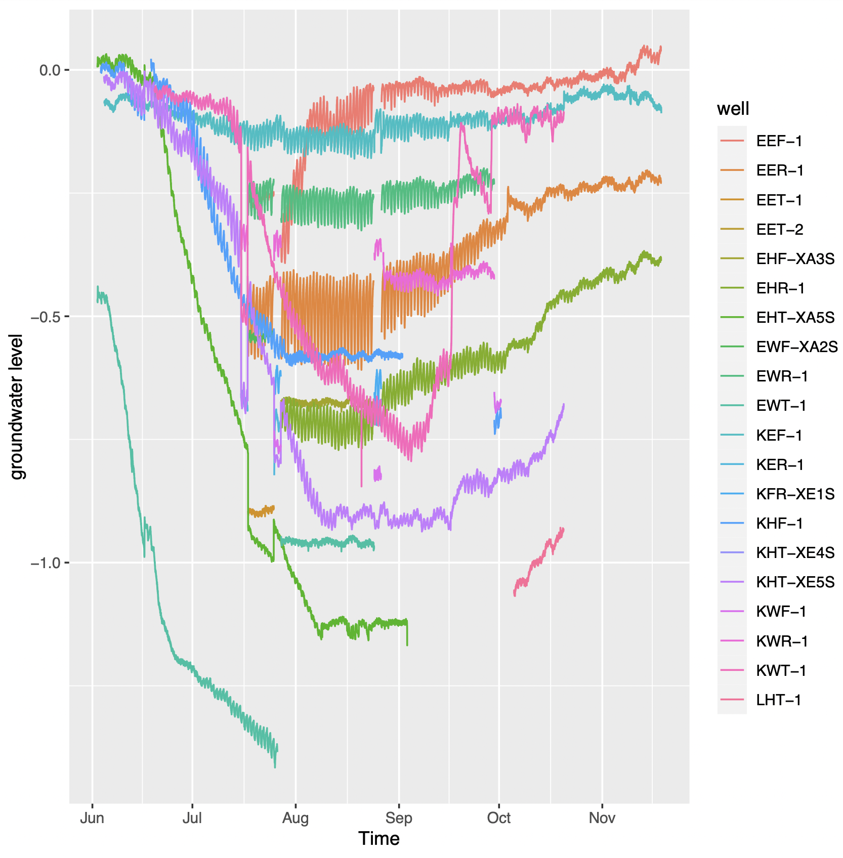
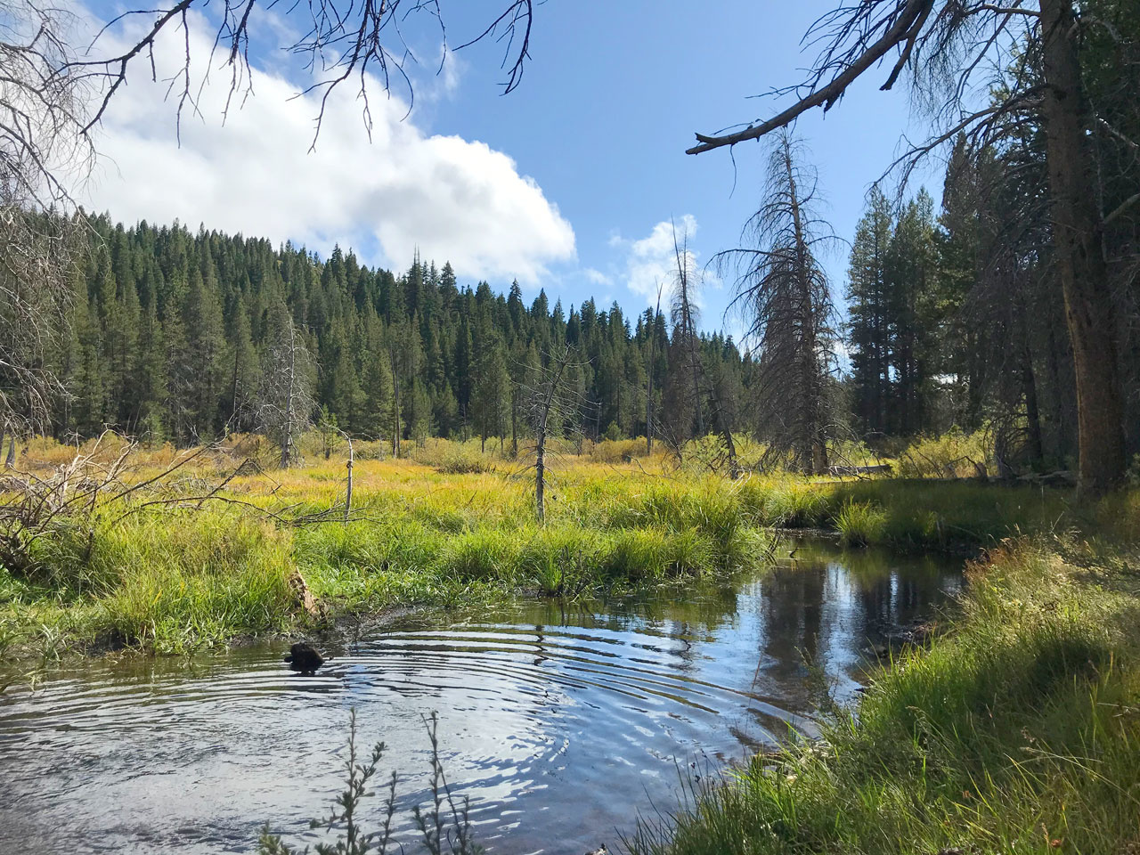
Time Series Analysis of Groundwater in Sierra Nevada Meadows
Using Multivariate Autoregressive (MAR) models to study how sunlight and temperature affect groundwater fluctuations
Julia Nicholson
Advisors: Albert Ruhi,
Jenifer Natali
Notes:
Hi, I’m Julia Nicholson and I’m an undergraduate studying pure math and computer science. This summer, I researched groundwater time series from the sierras, using multivariate autoregressive models. Specifically, I looked at how groundwater levels respond to changes in sunlight and air temperature.

Slide 2
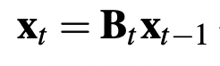
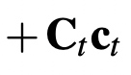
Multivariate Autoregressive MAR models
Multivariate : analyzes multiple time series at once. In this case, multiple wells in the same model
Autoregressive : considers past values as indicators of current values. (current groundwater levels depend on how high the groundwater was 10, 20 mins ago, etc.)
Variates : time series we want to understand (at Sagehen, groundwater levels)
Covariates : time series that may drive the variates (at Sagehen, Solar radiation or air temperature)
C matrices : how each time series
may be grouped together (at Sagehen,
Vegetation, geologic categories etc. may
group wells together)
Notes:
-The multivatriate in MAR means…
-The autoregressive in MAR means....
- MAR models look at variates and covariates.

Slide 3
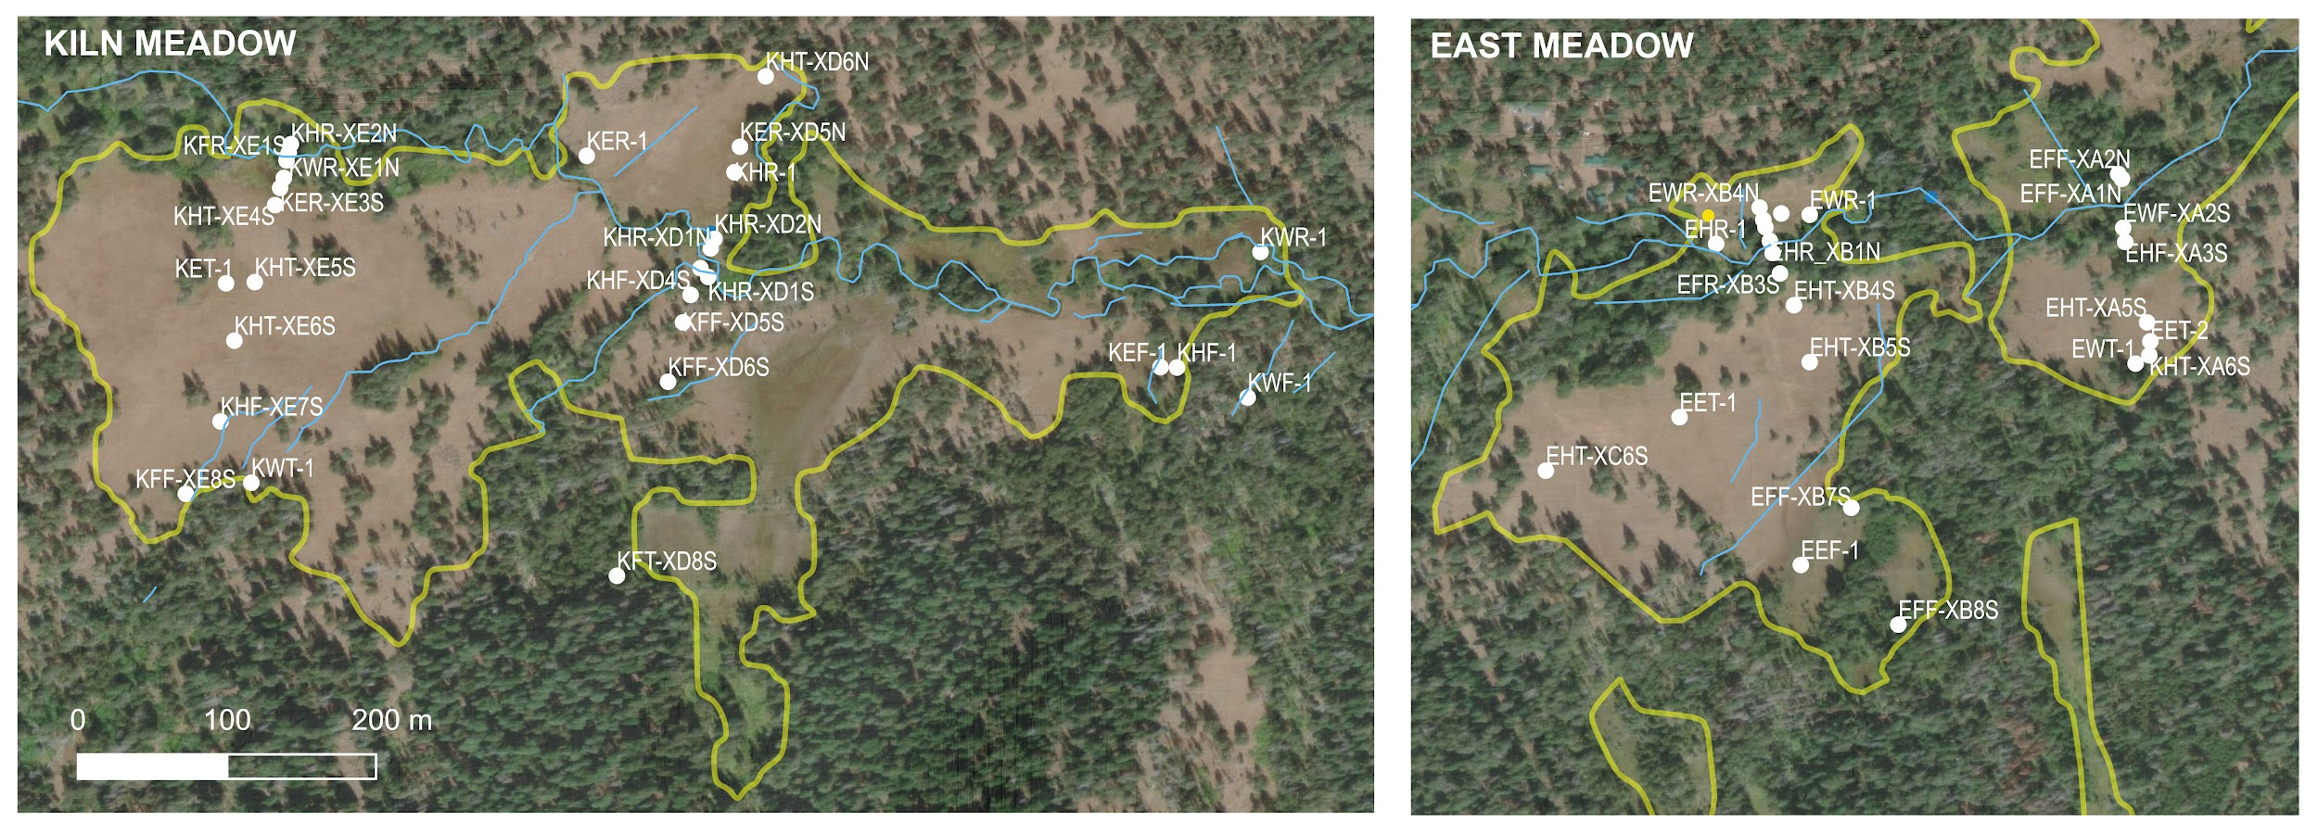
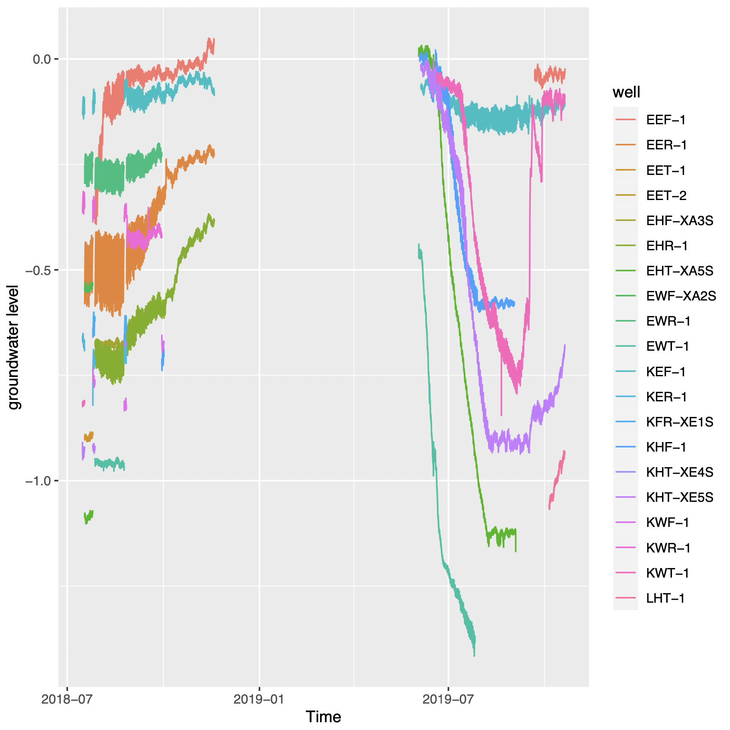
Variates : 19 wells in the Sagehen area
Frequency of time series: 1 observation per every ten minutes.
Notes:
The variates for the MAR models come from 19 wells in the saghen area.
In addition to measuring groundwater levels, Natali surveyed the vegetation surrounding each well, and the hydrology+geology surrounding each well, giving each well a category in plant functional type (PFT) and in hydrogeomorphic zone (HGMZ)
On the right is a graph of groundwater fluctuations in each of the 19 key wells that I surveyed.

Slide 4
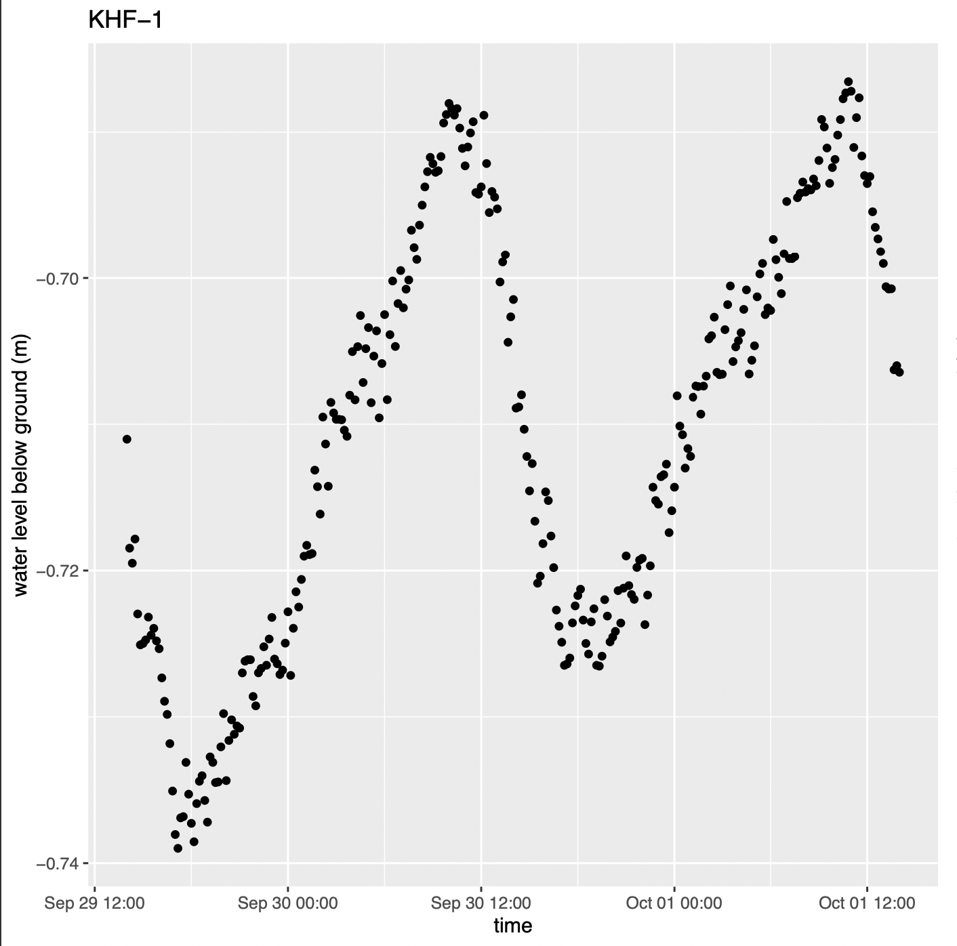
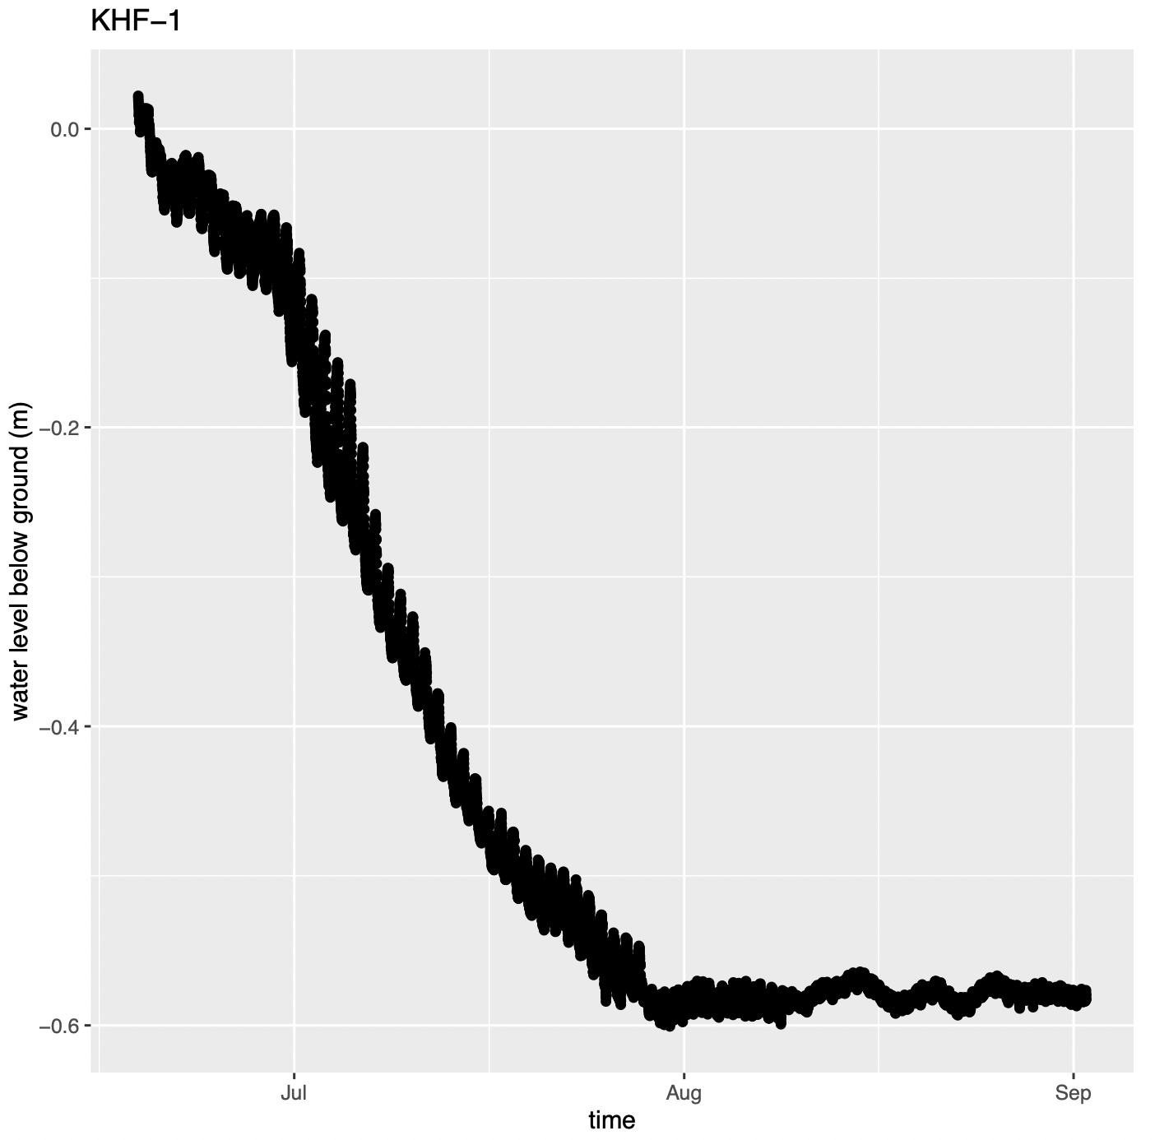
Notes:
Groundwater level fluctuates on a period of daily and yearly.

Slide 5
C Matrices : Different ways of grouping wells together
Universal : All wells are part of the same group.
Unique : Each well responds to the covariates differently.
Hydrogeomorphic Zone
Plant functional Type
Topographic Wetness Index
Meters to nearest channel
Meters to main channel (sagehen creek)
Meadow (whether the wells are in East or Kiln meadow)
Notes:
There were multiple C matrices that I used in the MAR models to test which worked best to describe groundwater fluctuation.
C matrices are used to group wells together. So a MAR model with a Plant functional type C matrix and SOL covariates is modeling the groundwater as though all areas with similar vegetation will respond to solar radiation in a simelar way.

Slide 6
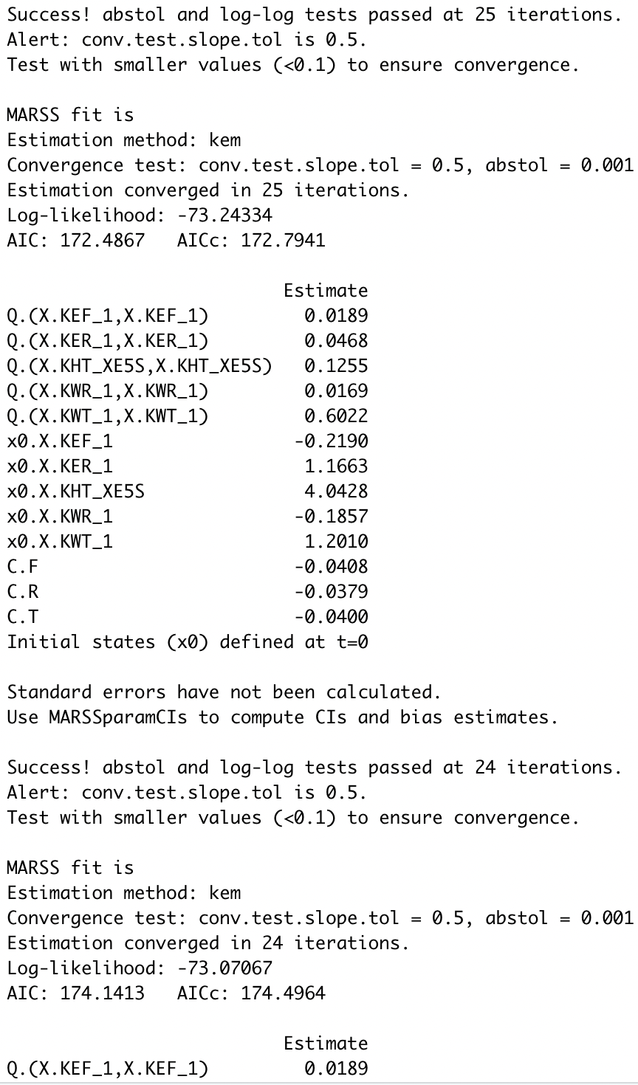
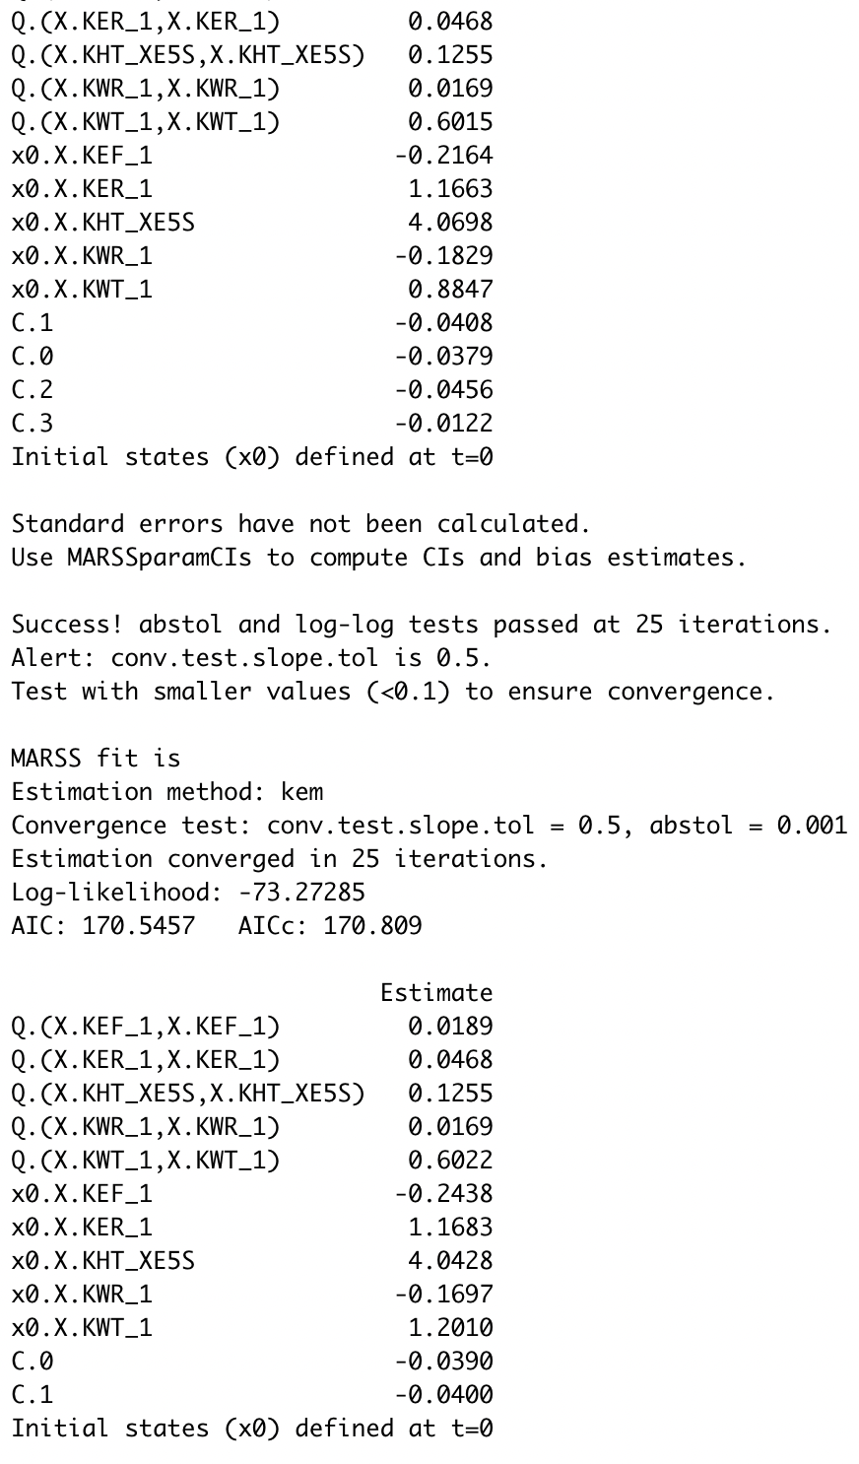
23 observation periods
X 2 covariates
X 8 C-matrices
_______________________
= 368 models !
Notes:
Because the time series were not continuous throughout all of 2018-2019 (meaning there were NAs and breaks), I broke the groundwater time series into 23 chunks of full data, which I call observation periods.
There were a lot of possibilities and permutations of observation periods, covariates, and C-matrices. To account for each combination, I wrote an R script to construct all of these models in one script, each model with a unique combination of variates, covariates, and C-matrix.

Slide 7
Analyzing the Resulting models: AICc scores
Akaike information criterion (AIC) score is an estimate predictive error for models. The lower the AIC score, the better quality a model is.
AICc score is an AIC score with an adjustment, to penalize models that overfit.
When comparing models, looked at ‘long’ vs. ‘short’ observation periods.
‘Long’ observation period: > 3 weeks
‘Short’ observation period: < 3 weeks
Notes:
After writing and running that script, I had 600 sumthin models to look through, and was faced with the problem of sorting through them to find which models performed the best.
One convention for comparing MAR models is comparing their AICc scores…
When comparing models, I sectioned the models off by whether they had AAT or SOL covariates and whether they had a ‘long’ or ‘short’ observation period. The long observation periods represent times when the sensors were left in wells for at least 3 weeks without taking them out. The short observation periods represent times when the sensors were left in the wells for less than that.

Slide 8
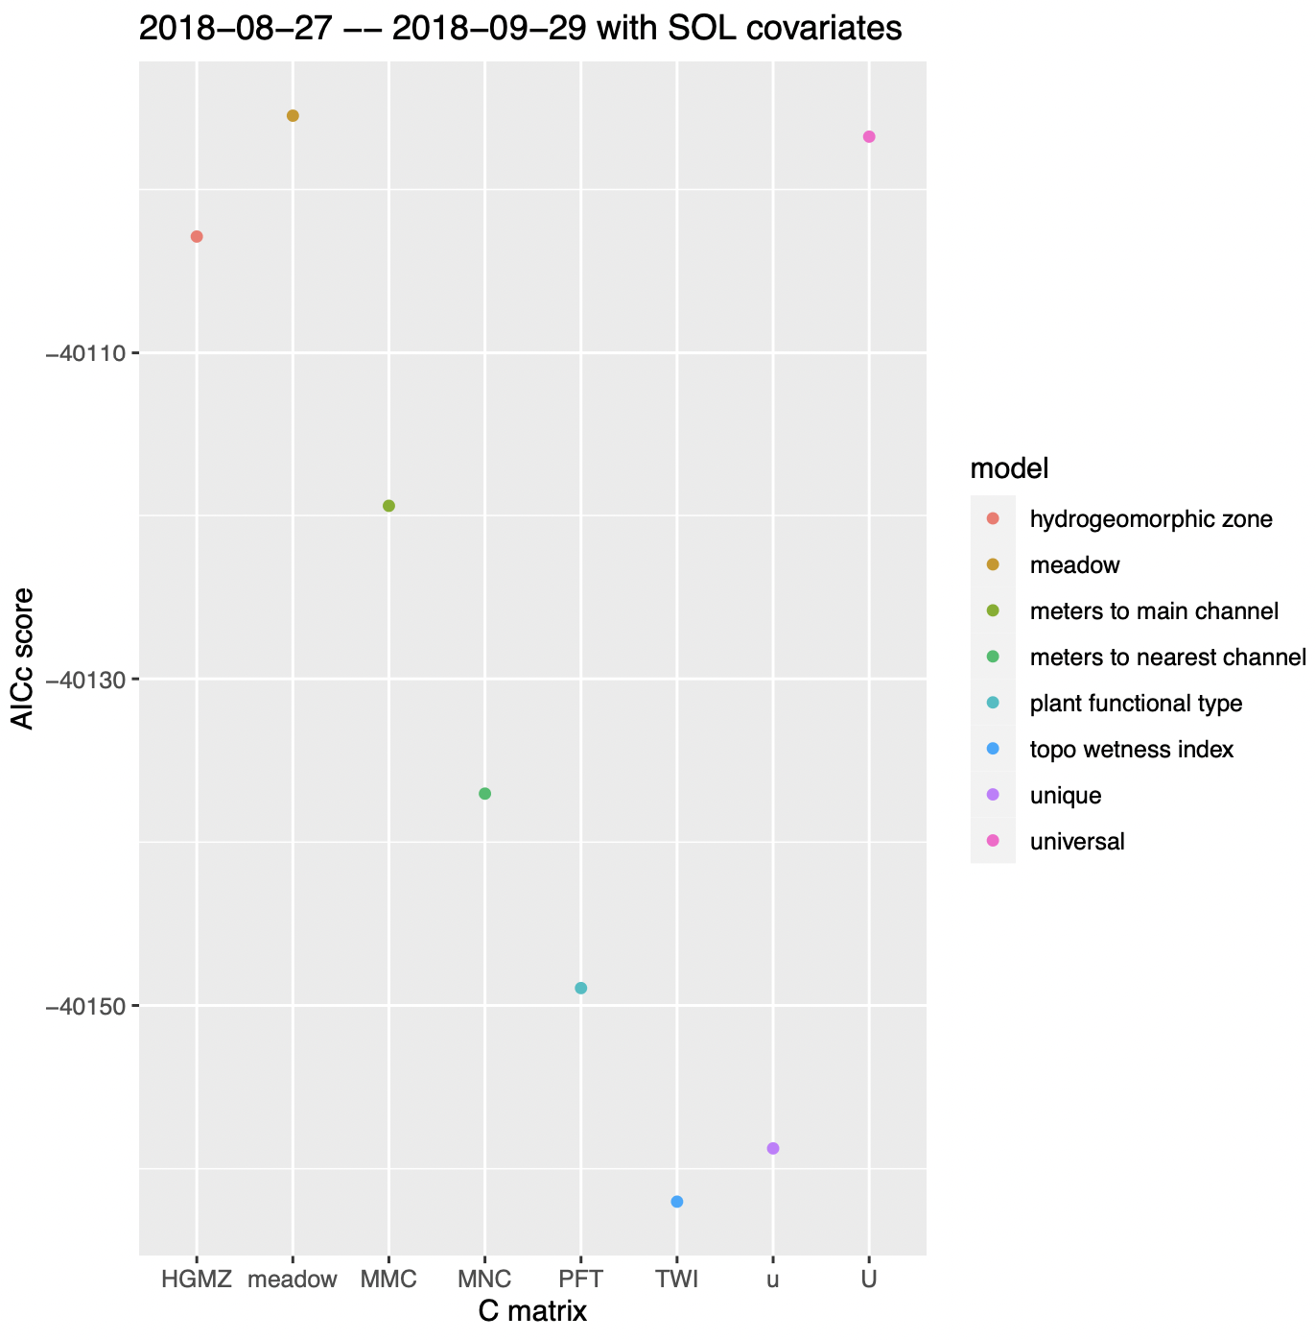

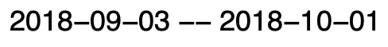
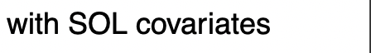
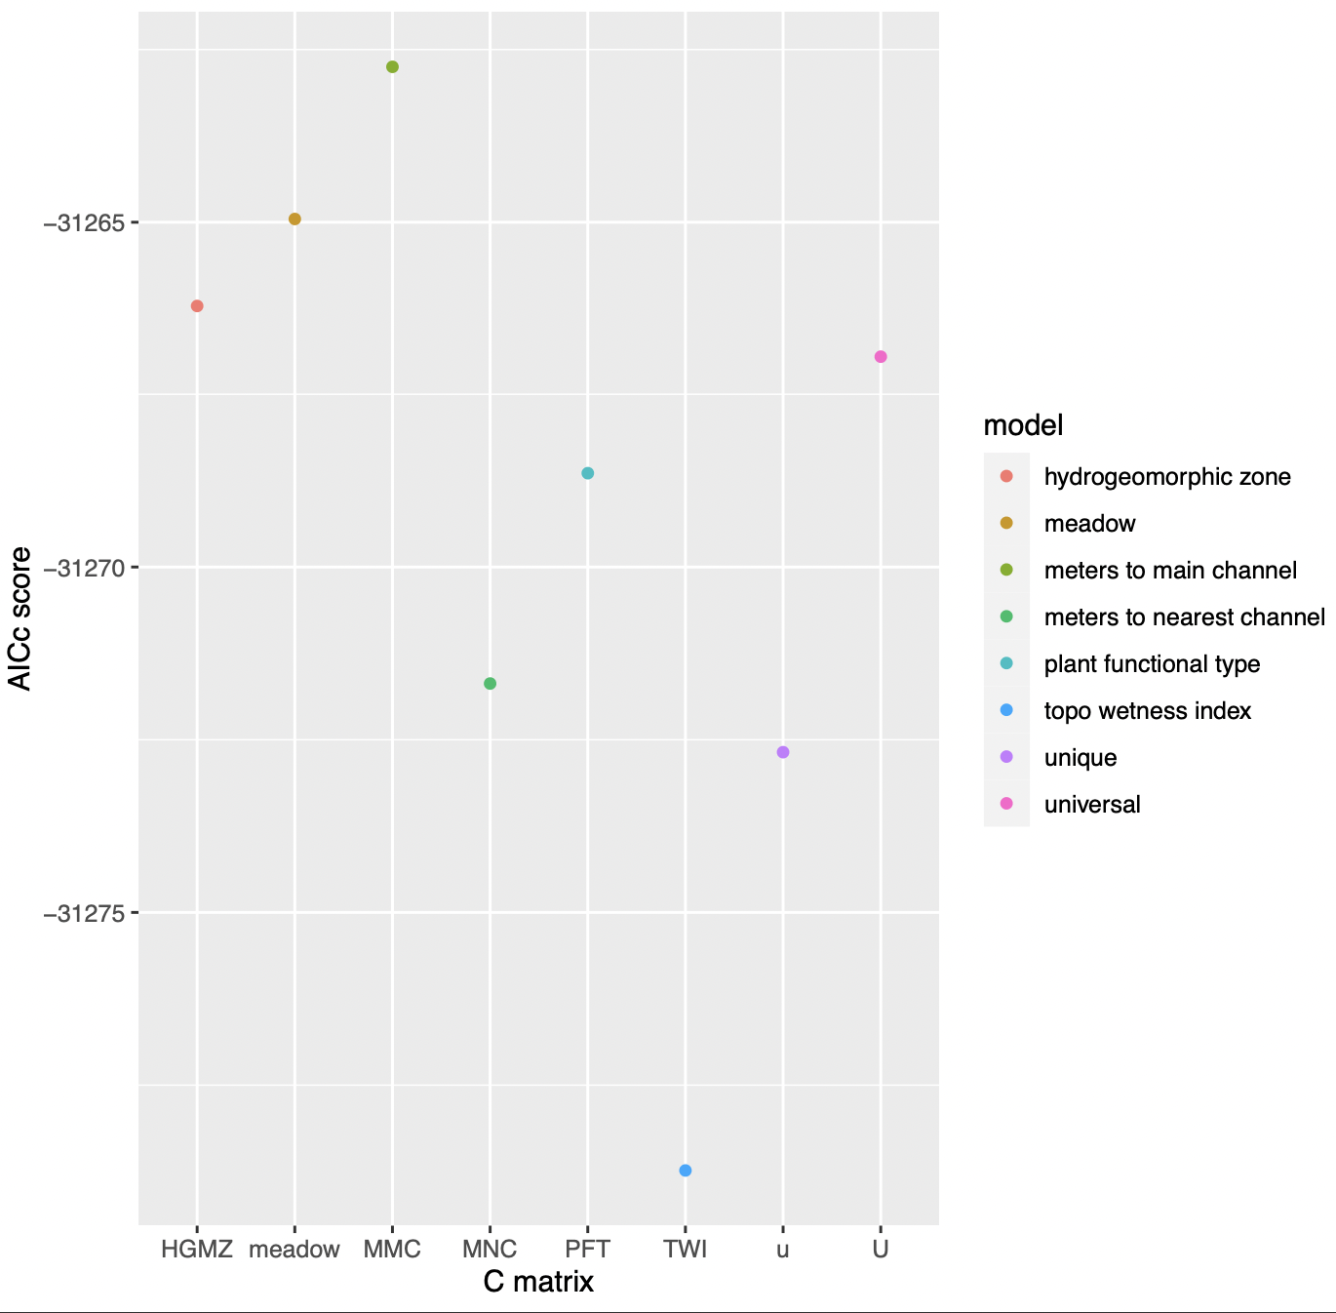
Findings: long observation periods + Solar radiation models, TWI is a good indicator.
Notes:
Because of time, I’m just going to talk about the models with solar radiation covariates.
Talk about TWI: topographic wetness index is a measure of how the landscape around an area affects how much water will seep into a location and into the groundwater below. TWI takes into account the slope of the ground as well as the upslope area that will potentially drain through the location.
Talk about how to read the graphs -- remember the lower the AICc, the better the model does.
These are just a few examples out of hundreds of models.
From these MAR models, it seems that how groundwater levels respond to solar radiation depends on the Topographic wetness index in the area.
When you think about it, this is plausible. TWI is a measure of wetness, so perhaps wetter areas, which have groundwater levels closer to the surface, would be more susceptible to fluctuations due to solar radiation, as opposed to areas with a TWI that indicates the area is less wet.
XXXX Climate change relate: With climate change, solar radiation will become stronger, although the periodicity of the radiation shouldn’t change. So it’s a possibility that conservation efforts in light of climate change would involve specialized protocols for meadow ecosystems depending on areas’ TWIs.
From these MAR models, it seems that how groundwater levels respond to solar radiation depends on the Topographic wetness index in the area.
From these MAR models, it seems that how groundwater levels respond to solar radiation depends on the Topographic wetness index in the area.

Slide 9
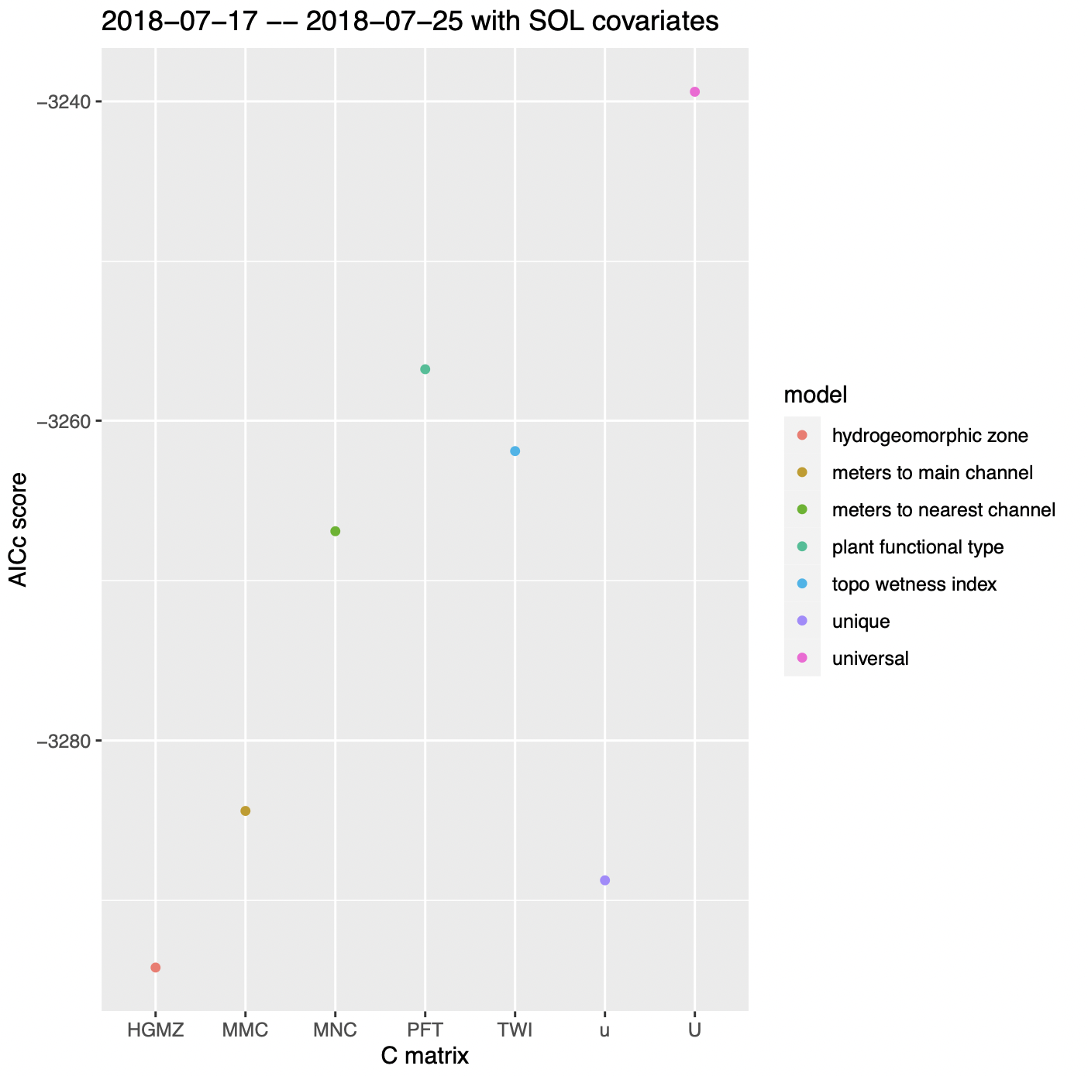

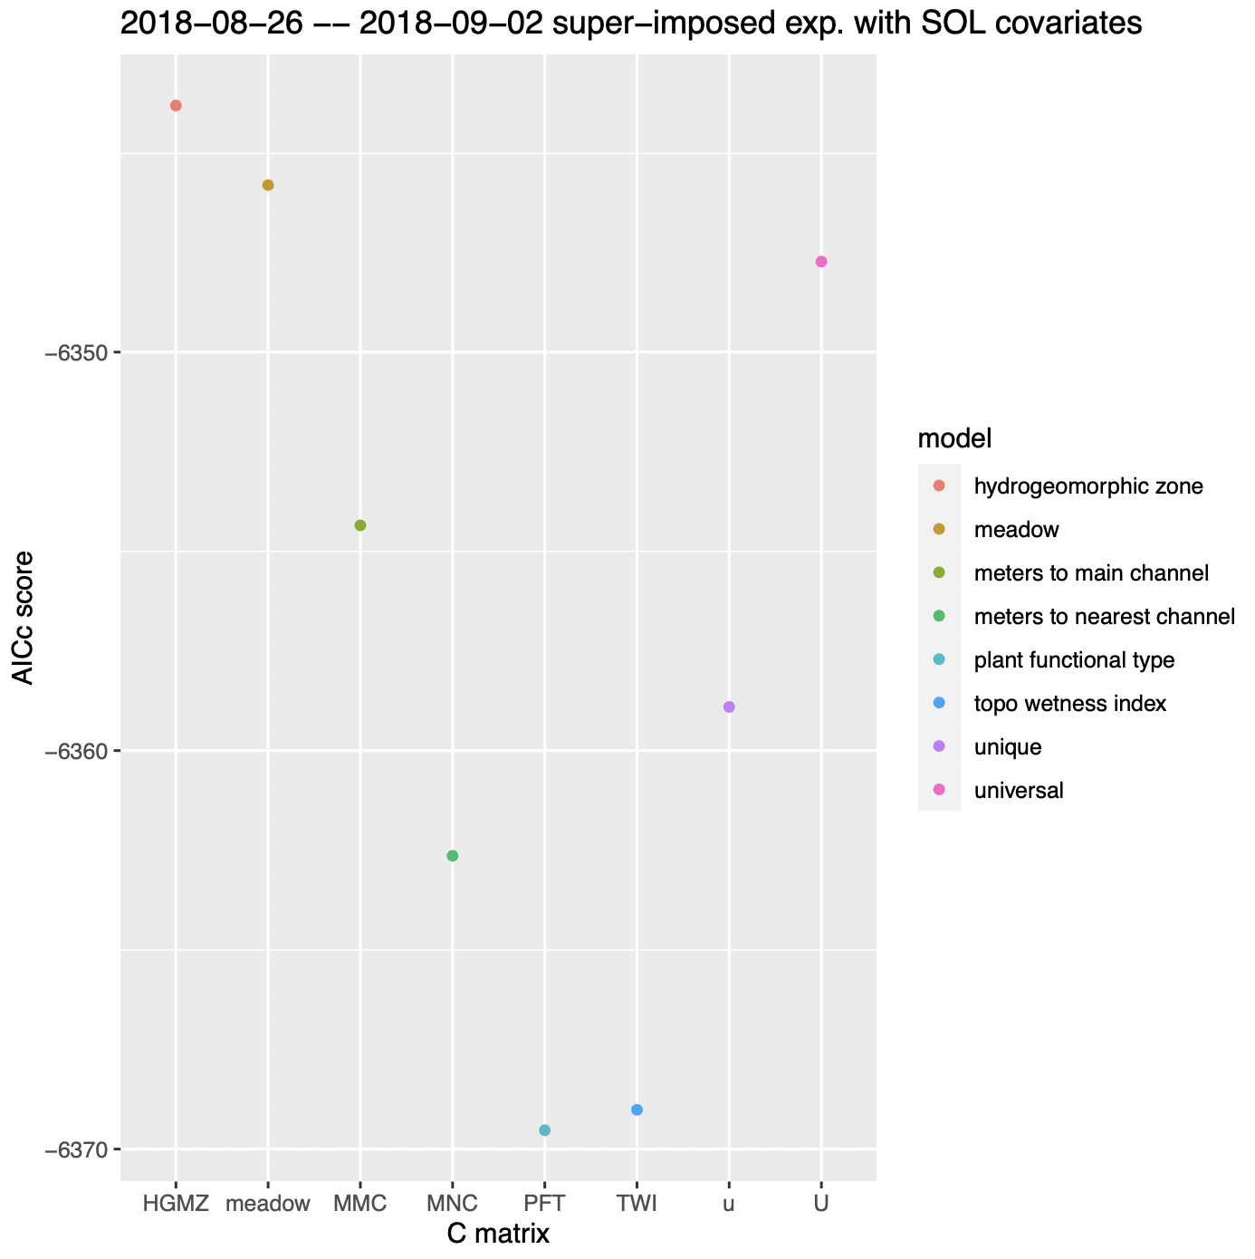

Findings: short observation periods + Solar radiation models, HGMZ and PFT are good indicators.
Notes:
From these MAR models, it seems that how groundwater levels respond to solar radiation on a shorter timespan depends on the surrounding plants and geology.
Throughout these shorter observation period models, HGMZ is a good indicator. I thought it was interesting that this is different from the longer observation periods with the same (solar radiation) covariates. One interpretation is that while Topographic wetness index of a point is a good indicator for long term trends of how groundwater will respond to sunlight, on a day-to-day basis, it’s the local geology that determines this response.
After late august, PFT starts doing well as an indicator. I’m not sure what a good interpretation of this result is. One I’ve thought about is by late august, the groundwater levels start getting low relative to the rest of the year. Perhaps once the groundwater levels have reached a certain depth, the plant-powered process of evapotranspiration is a larger factor in how the groundwater responds to solar radiation.

Slide 10
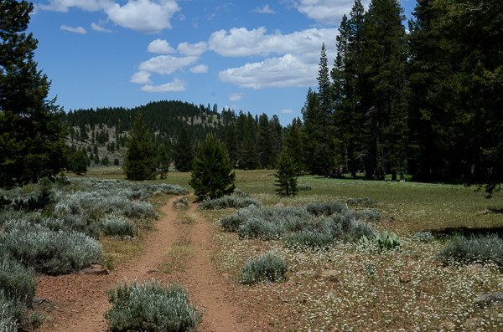
Moving on...
There is still data in these models left to sift through!
Models with Solar covariates and a lag of 6 hrs.
Thanks so much to Jen Natali and Albert Ruhi for supporting me this summer!
Notes:
There is still data in these models left to sift through! I’m looking into other possible ways of comparing models other than AICc scores, for example. I’d like to thank Jen Natali and Albert Ruhi for supporting me this summer, and thank you to you all for listening.

